Slide 1
Season Kick-Off Meeting
November 13, 2023

Slide 2
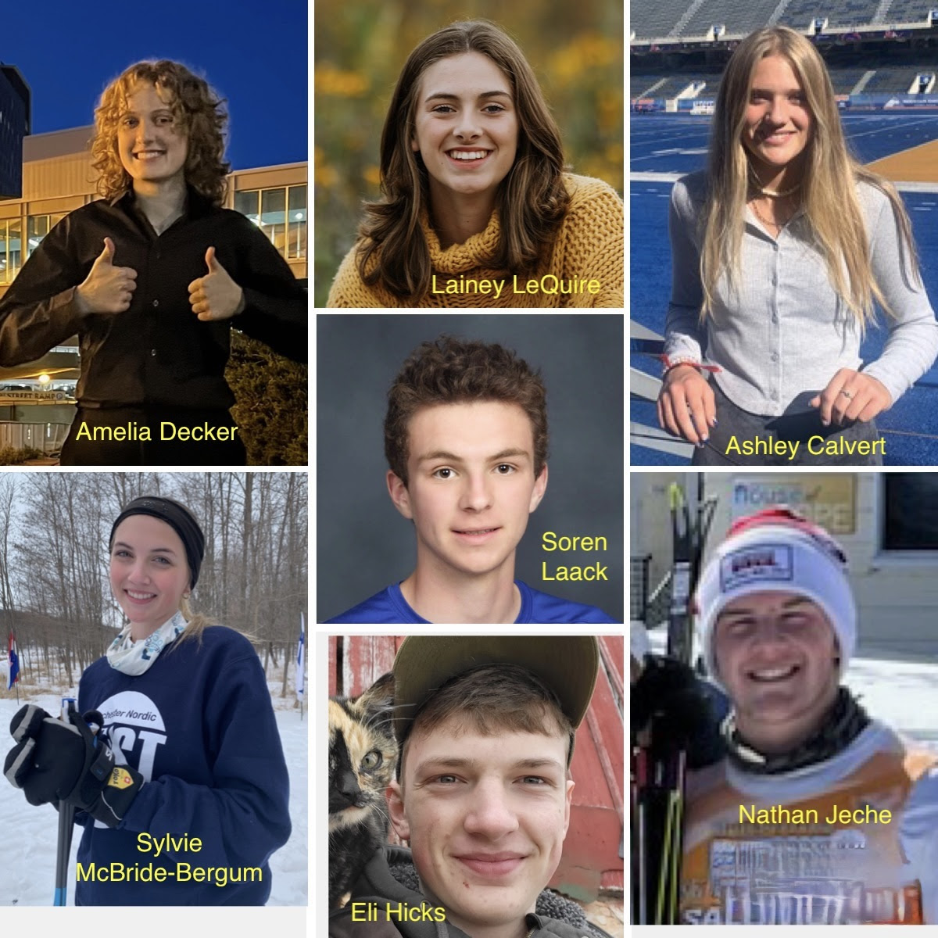
Team Captains
Ashley Calvert
Century High School
Amelia Decker
Mayo High School
Eli Hicks
Homeschool
Nathan Jeche
Stewartville High School
Soren Laack
Mayo High School
Lainey LeQuire
John Marshall High School
Sylvie McBride-Bergum
Mayo High School

Slide 3
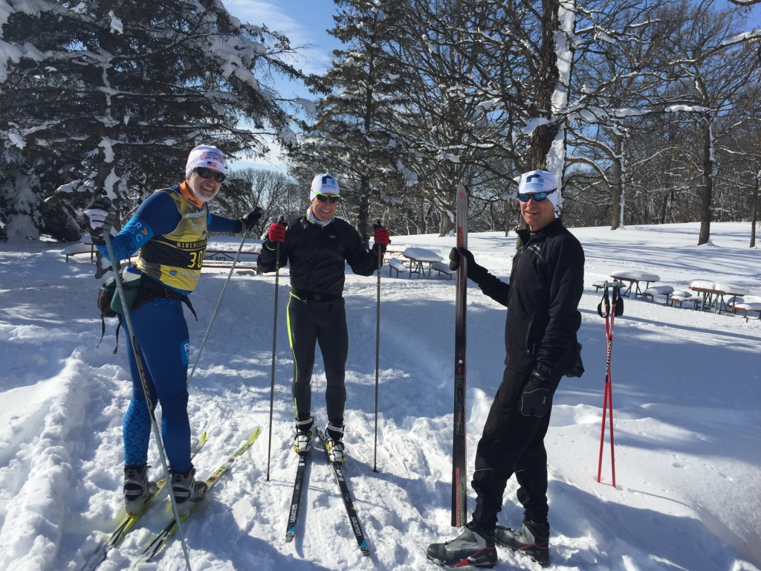
Volunteer Coaching Staff:
Shawn Baranczyk
Mark Behrends
Jim Bennett
Darald Bothun
Roberto Cattaneo
Erin Dewey
Steven Felton
Joey Furst
Joe Gyura
Curt Hale
David Herbert
Olivia Holland
Mike Holmes
Jack Jagielski
Sarah Johnson
Joey Keillor
Nathan Kennedy
Barry Knapp
Jennifer Lisowe
Marianne Luetmer
Bob MacCarty
Bob Manulik
Catherine McBride (yoga)
Michael O’Connor
Maureen O’Shaughnessy
Brett Ostby
Tobias Peikert
Rich Peter
Joan Rabe
Jakob Ratelle
John Resman
Austin Reynolds
Franz Rinkleff
Luke Russell
Wayne Sadecki
Anna Sortland
Katherine Teigen
Mike Trantow
Denny Truelson
Kelly Van Camp
Henry Walker
Robb Welch
Danny Whipple
Peter Wollan
Andy Wood
Chris Ziegler
Bob Ziller

Slide 4
2023-2024 Season Schedule Overview See Handbook and Google Calendar for detailed schedule
Important Dates:
Nov 14 & 16 Captains Practices, Soldiers Field, 4-5pm
Nov. 20 Mandatory Equipment Orientation – First Yr. Skiers
Nov 27 Regular Practice Schedule Begins
Dec. 21 Last Practice before Winter Break
Jan. 2 Regular Practice Resumes
Jan. 5-7 Heartwood Ski Trip *Optional
Mar. 7 Last Practice

Slide 5
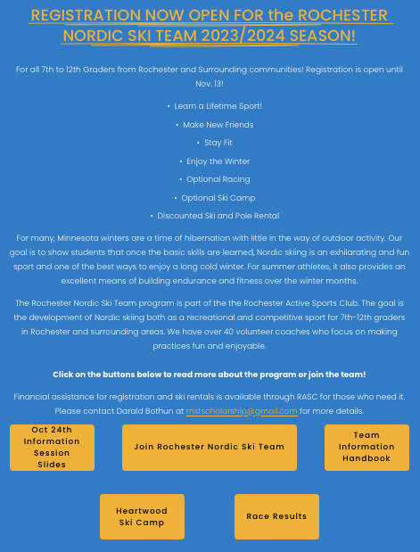
1. Go to RASC-mn.org
2. Click on Rochester
Nordic Ski Team
3. Click on a box to Register (for the team and Heartwood) and for the Handbook

Slide 6
Registration, Ski Rental, and Heartwood Ski Camp Options

Slide 7
RENTAL SKIS AND POLES
RNST Rental Skis only have Prolink bindings on them now.
These bindings only work with Prolink or NNN boots with one bar
The Rental Ski bindings do not work with boots designed for SNS bindings or earlier Salomon one-bar bindings.
Skiers planning to rent skis from RNST should get boots with one bar that are designed to work with Prolink or NNN bindings.

Slide 8
First Year Skiers Mandatory Equipment Orientation
Monday, Nov. 20, 4-5pm, Century HS Cafeteria
Bring:
Skis
Skate boots
Poles
Gloves or Mittens you will use at practices (when it is usually 20 degrees or colder)
RNST Coaches will show you how to put your skis, boots and poles on and off, adjust your pole straps and coach you on how to prepare to practice in cold temps

Slide 9
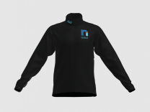
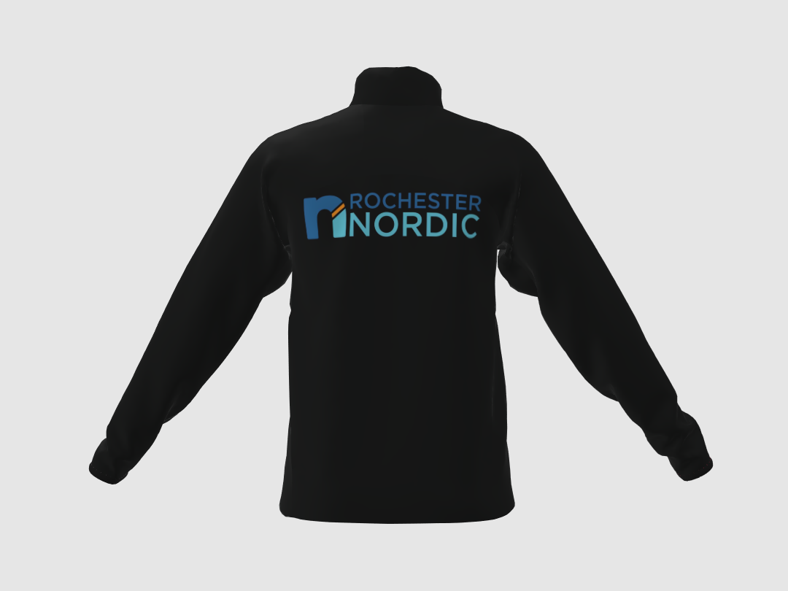
ORDER OPTIONAL TEAM GEAR BEFORE NOV 15!
Rochester Nordic Ski Team Jackets
Rochester Nordic Ski Team Pants
Podiumwear Team Jacket is available to order through an online store.
Online store will close at midnight on November 16th.
Price: $150 plus $5 for shipping.
Craft “Advanced Nordic Training Pant” available to order through Tyrol Ski & Sports.
Available in a women’s and a men’s version.
Price: $73.00 (retail price $129.00). Prepay at time of order.
Orders can be placed at Tyrol until November 15th.

Slide 10
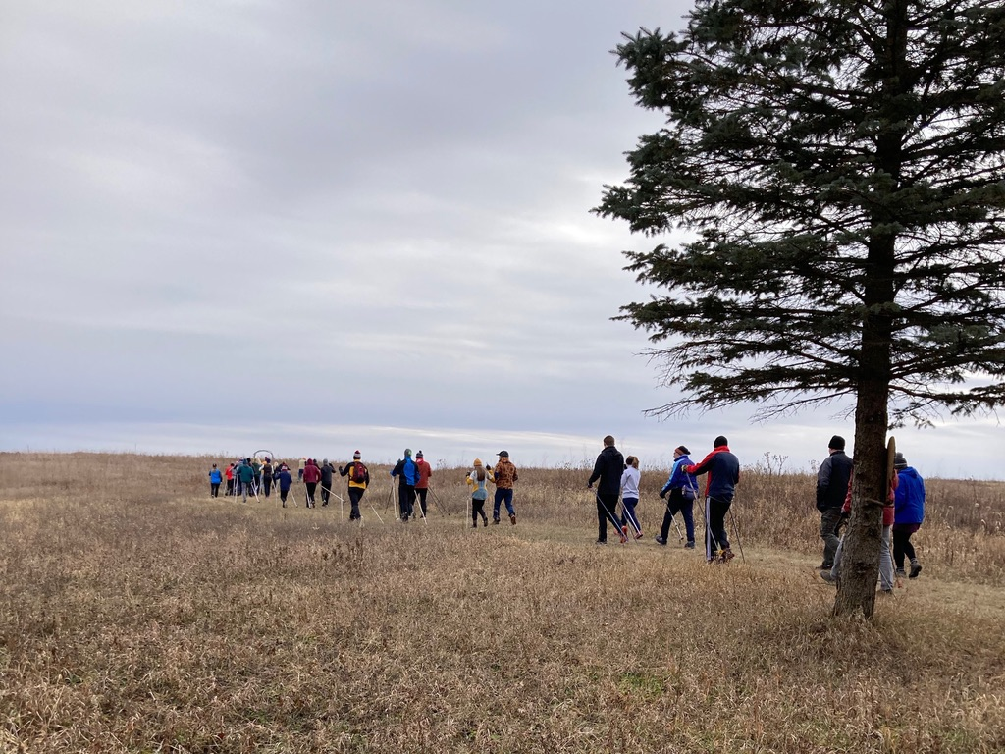
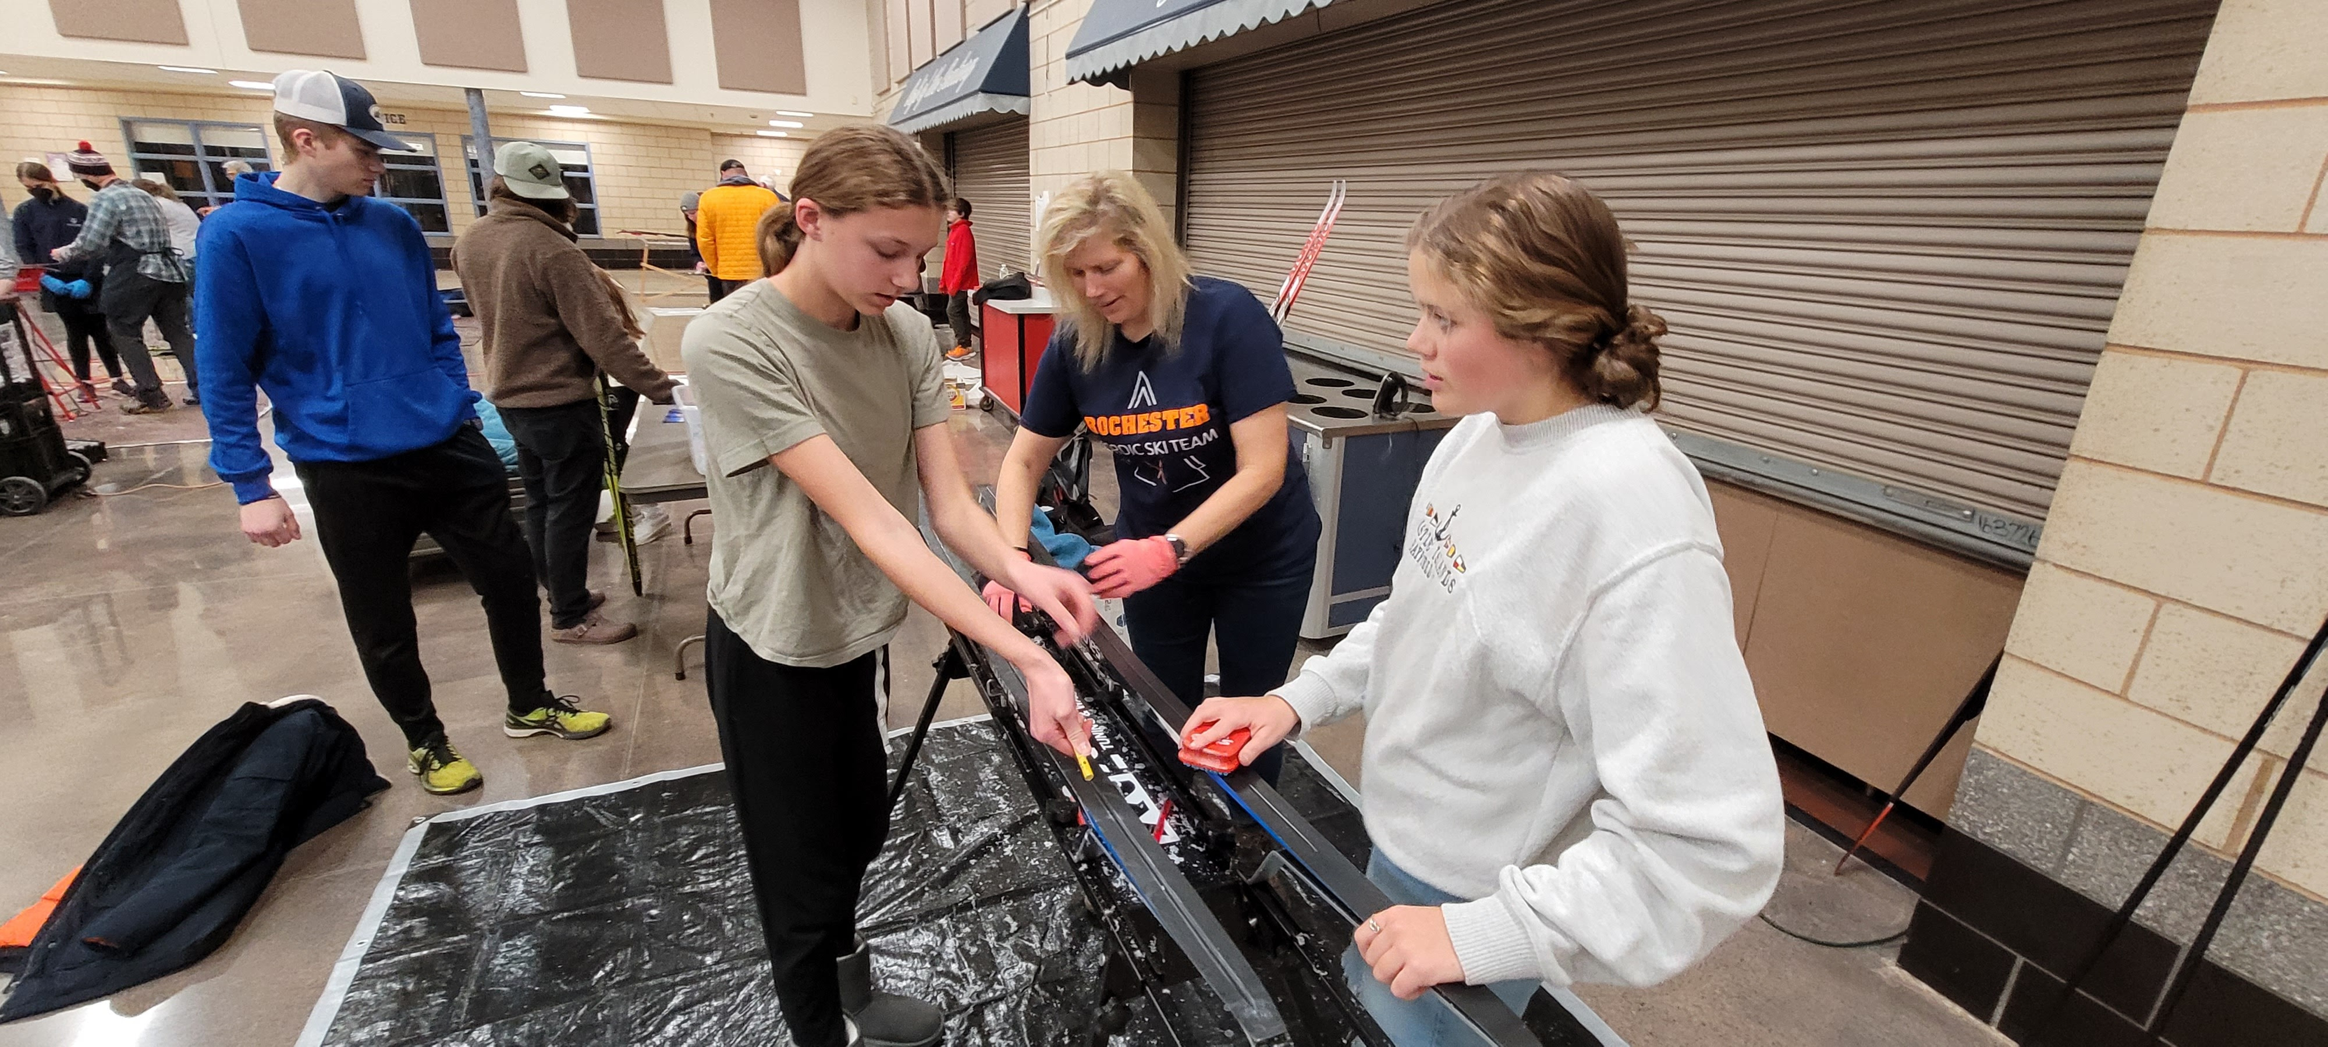
Important EARLY Dates
Nov. 14 Captains Practice, Soldiers Field, 4-5pm
Nov 15 Deadline for ordering optional team wear
Nov. 16 Captains Practice, Soldiers Field, 4-5pm
Nov 20 Mandatory Equipment Orientation – First Yr. Skiers
Nov 27 Regular Practice Schedule Begins:
M, T, Th: check-in 3:45; practice 4-5:30pm
We will communicate if Dryland or On-Snow
Dec 2 Optional Trail Bounding, Bonfire, Hot Chocolate
at Cedar Ridge Farm
Dec 8 Deadline for signing up for Heartwood Ski Camp
Dec 13 Optional Ski Waxing Session
4-5:30pm at Century HS
Dec 21 Last Practice before Winter Break
Trail Bounding – Cedar Ridge Farm
Waxing Session – Fall 2022

Slide 11
Communication
RNST Emails and Text Messages (using “REMIND”) are primary communication tools.
All parent and skier contact information provided during registration will be added to these two communication platforms.
RNST Google Calendar: can be added to your own calendar and synced to your phone.
Facebook: https://www.facebook.com/RochesterActiveSportsClub
Instagram: Go to Instagram page “RochesterActiveSportsClub”

Slide 12
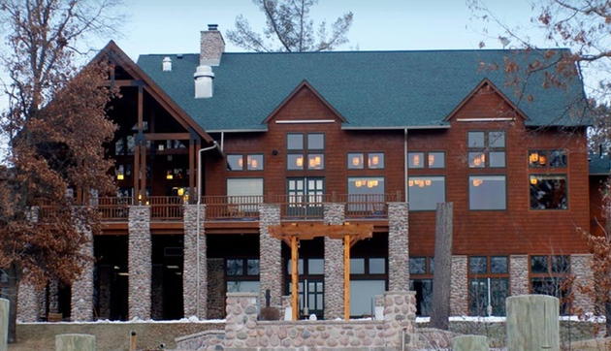
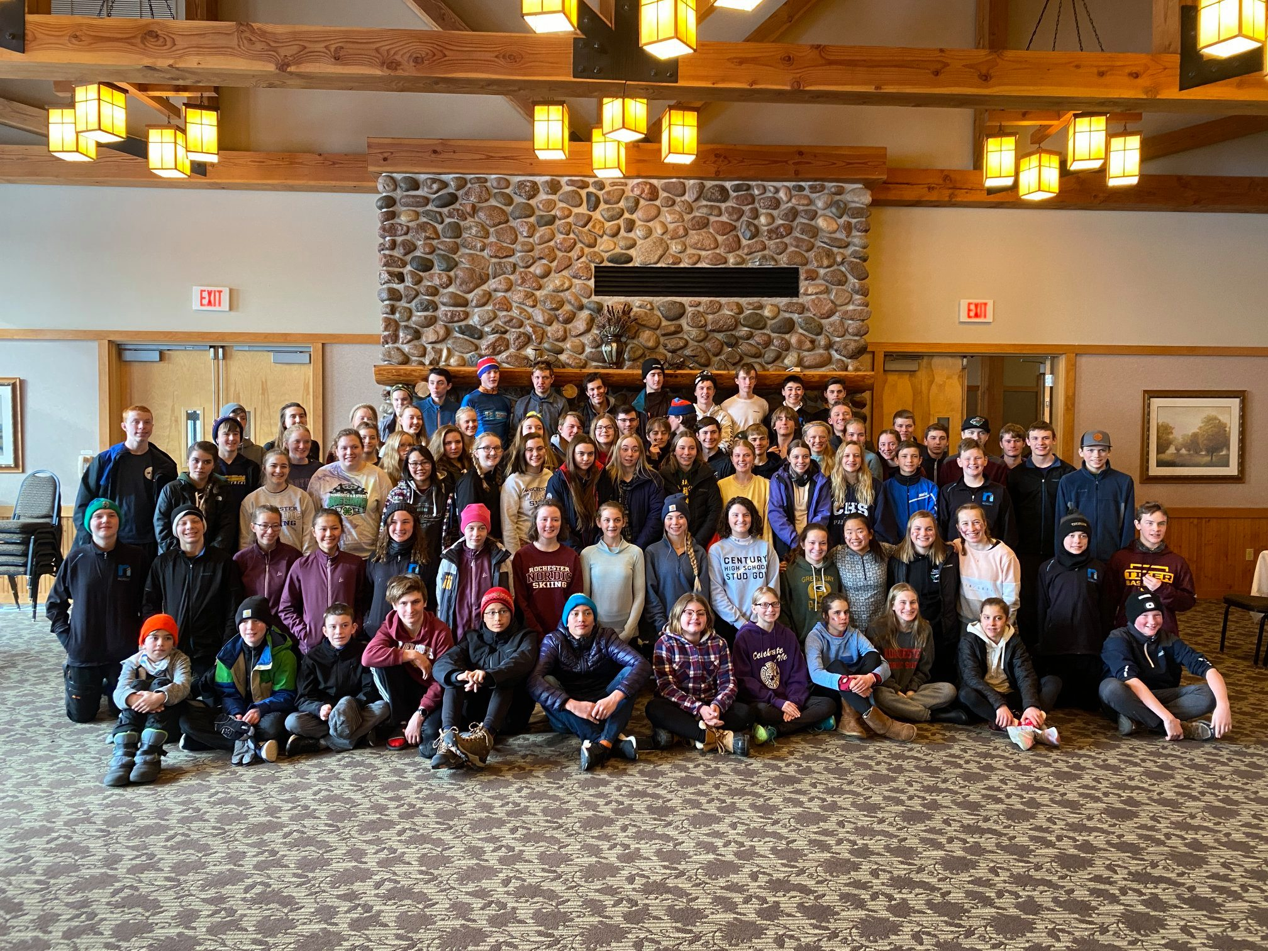
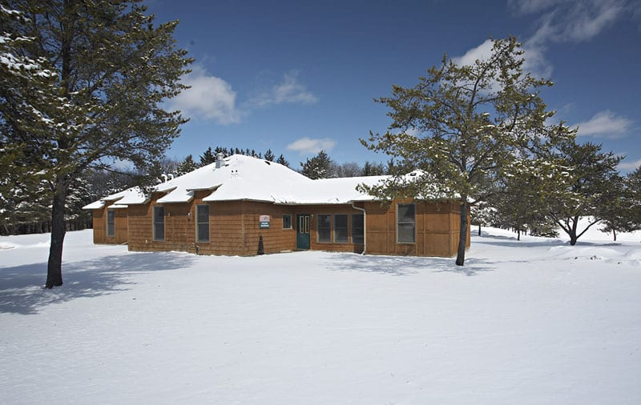
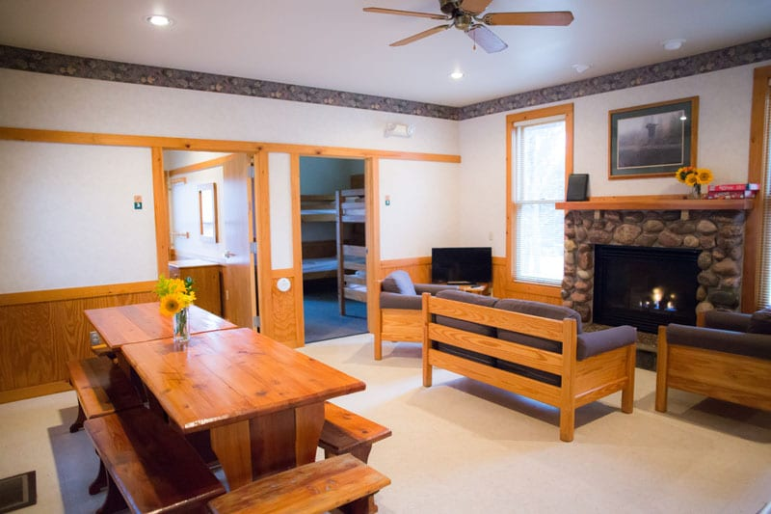
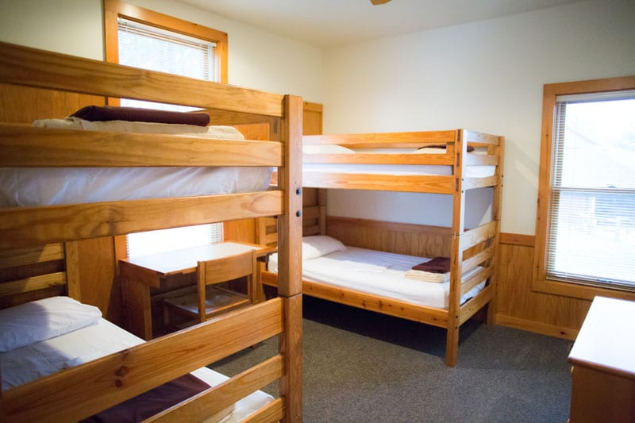
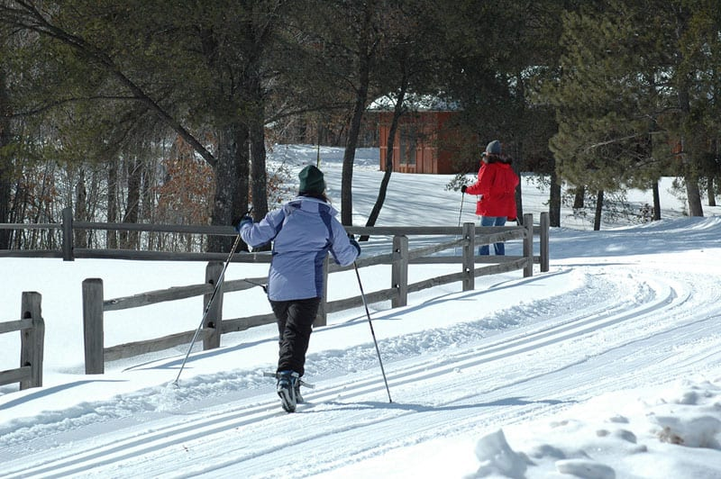
Heartwood Ski Camp: Jan 5-7, Trego, WI
Sign-up Deadline: Dec. 8!
Go to rasc-mn.org/rnst-store $250 per skier

Slide 13
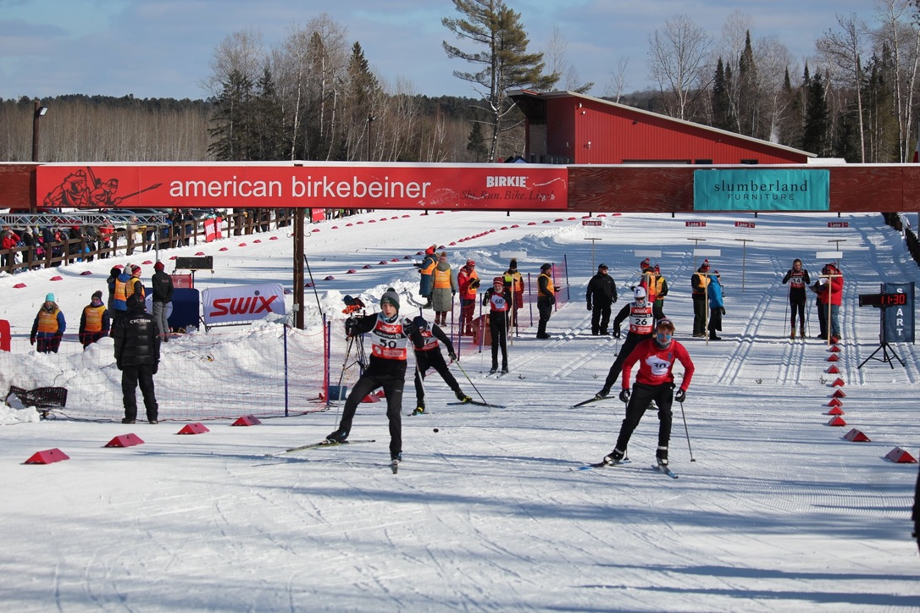
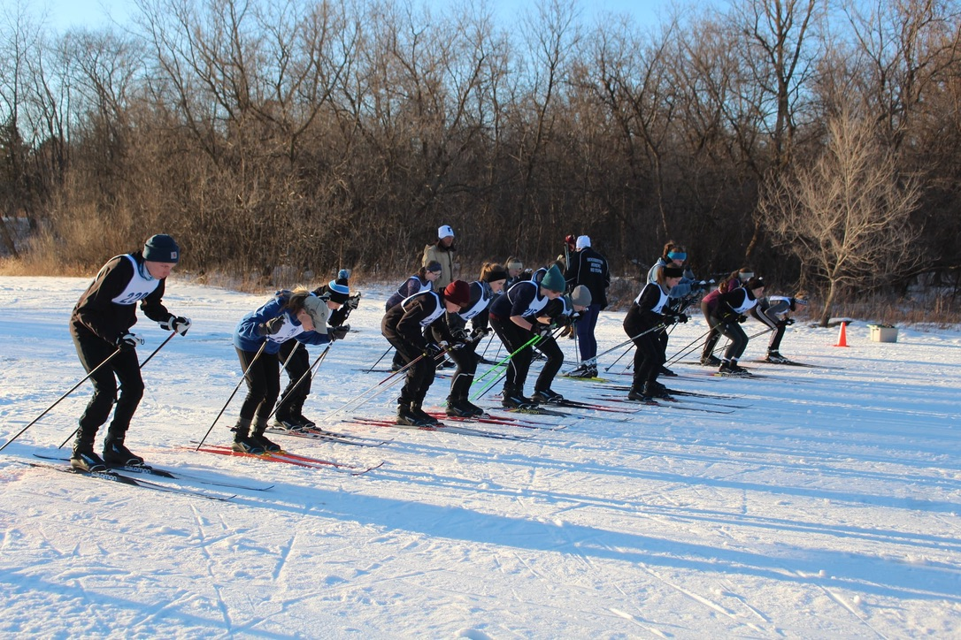
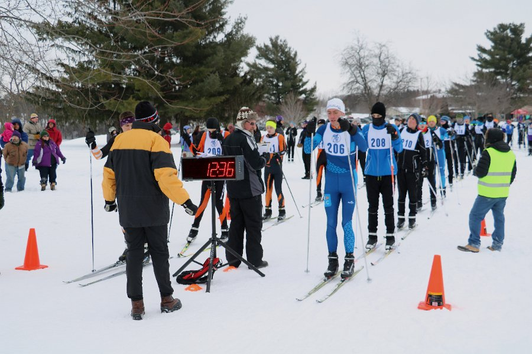
Competitive Events
2023-2024 Meets
All Skiers
Rochester Invite
Intra-Team Time Trials
Winona
WI State Championships (optional)
Date & Times TBD
Experienced Skiers/Coach Recommendation
CXC and other Citizen races

Slide 14
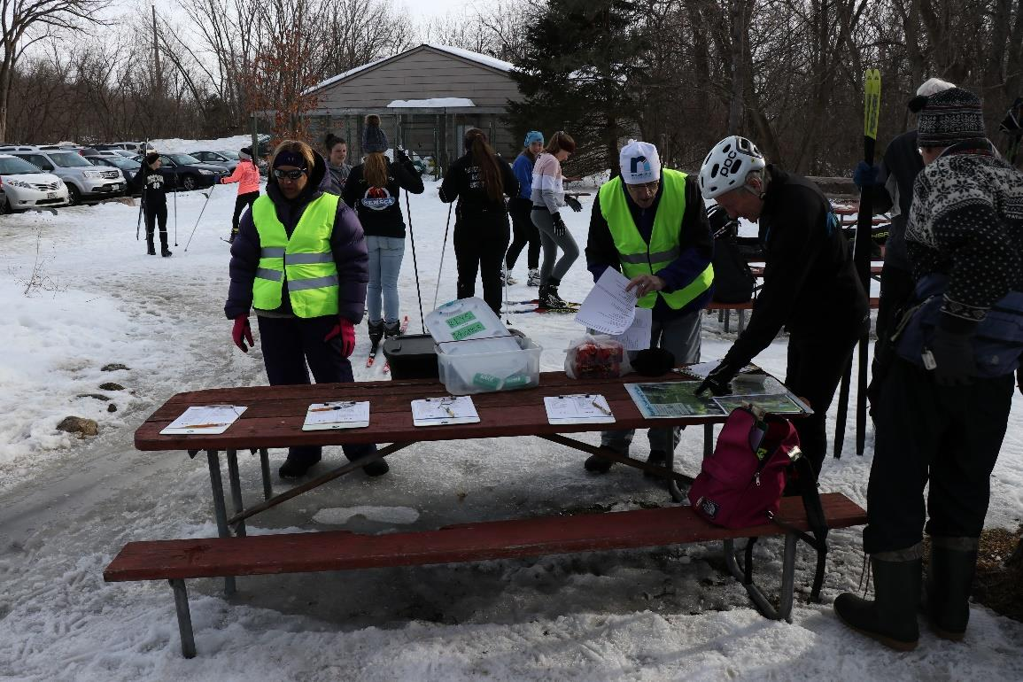
Parent Volunteers
Parents are an integral part of our team - Please sign up to Volunteer!
We rely on parent support for our Check In/Check Out system. We ask that each parent volunteer at one practice during the season.
We may also enlist your help for our home race.
Please sign up using the link you will see in weekly emails or on the RNST web page at rasc-mn.org/rnst

Slide 15
Think Snow!

